Slide 1





Temporal Image Registration using deep learning
for 3D Fetal Echocardiography
Kazi Saeed Alam
Supervisors: Md Kamrul Hasan,
Dr Choon Hwai Yap Department of Bioengineering,
Imperial College London, UK

Slide 2

Outline
Introduction
State of the Art
Dataset description
Proposed Registration Framework
Results
Conclusion & Future Remarks
References

Slide 3
Introduction
The fetal heart can experience congenital heart malformation and functional abnormalities.
Ultrasound imaging plays a vital role in assessing the heart of the developing fetus due to its non-invasive nature.
Heart chambers, valves, blood flow patterns, etc. can be used as good identifiers to detect and evaluate several cardiac diseases.
However, the detection of heart problems in fetus via mass screening is only around 50%
The clinical use of echo is still stuck with 2D
Most of the works are based on adult hearts

Slide 4
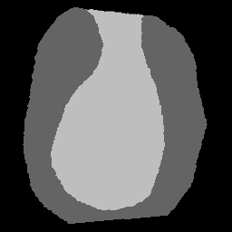
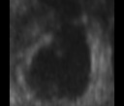

Temporal Image Registration
Segmentation branch
t=1
t=1
Motion information sharing??
(for anatomical constrain)
t=n
t=n
Segmentation branch

Slide 5
The estimation of the deformation field by registration between two time points can help share the information between two segmentation branches [1][2][3].
[1] Gupta, Soumya, et al. "Multi-class motion-based semantic segmentation for ureteroscopy and laser lithotripsy." Computerized Medical Imaging and Graphics 101 (2022): 102112.
[2] Gupta, Soumya, et al. "Mi-unet: Improved segmentation in ureteroscopy." 2020 IEEE 17th International Symposium on Biomedical Imaging (ISBI). IEEE, 2020.
[3] Xue, Wufeng, et al. "Improved Segmentation of Echocardiography With Orientation-Congruency of Optical Flow and Motion-Enhanced Segmentation." IEEE Journal of Biomedical and Health Informatics 26.12 (2022): 6105-6115.

Slide 6
State Of the Art (Dataset)
Public Dataset for 3D echocardiography is very rare.
2 very well known public datasets are:
CAMUS [5] :
the largest publicly-available and fully-annotated
Limitations: data is 2D and from adult hearts
CETUS [14] : 45 3D echocardiographic sequences
Adult hearts
Nurmaini et. Al. [13] worked on a private dataset of 1149 2D images for fetal hearts.

Slide 7
State Of the Art (Methods)
*Dice for Intra observer variability 0.930
Work | Description | Result ( Mean Dice Score)
Smistad et al. [15] 2017 | used U-Net CNN to segment the left ventricle in 2D ultrasound images. | 0.87 on LV (manual annotated test set)
Oktay et al. [16] 2019 | used anatomically constrained neural network (ACNN) segment the 3D LV structure . Uses segmentation aware maps to add anatomically constraints | 0.912 (ED) and 0.873 (ES) on CETUS dataset
Wei et al. [18] 2020 | proposed appearance and shape level co-learning mutual benefits of the segmentation and tracking | 0.929 for LV and Myo on CAMUS dataset

Slide 8
State Of the Art (Methods)
*Dice for Intra observer variability 0.930
Work | Description | Result ( Mean Dice Score)
Zhang et al. [18] 2022 | dual-branch TransV-Net (DBTV) V-shaped encoder-decoder branches extract the additional edge features | 0.913 and 0.880 for left and right ventricle segments on CAMUS Dataset
Sfakianakis et al. [17] 2023 | used ensemble of CNNs based on the U-net architecture Incorporated geometrically constrained data augmentation method based | 0.929 on LV and endocardium on CAMUS Dataset
Ling et al. [19] 2023 | proposed four models based on nnUNet (53M parameters) data augmentation in both training and inference, combined with a well-matched optimization scheme | 0.935 crossing Intra observer variability dice score for LV and myo on CAMUS dataset

Slide 9
Fetal Data Annotation (3D)

Slide 10
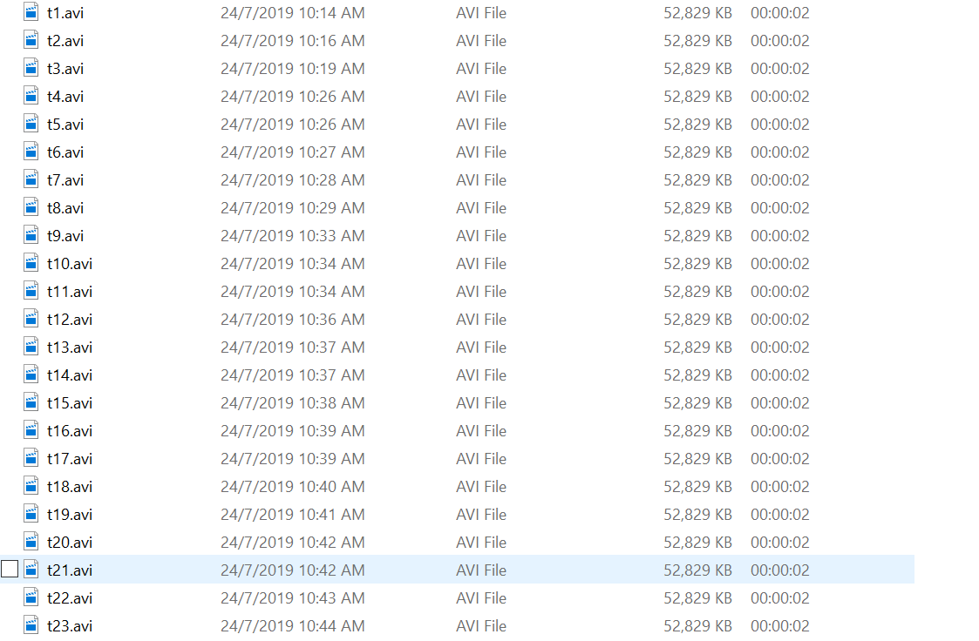
Generate video VOL → AVI

Slide 11
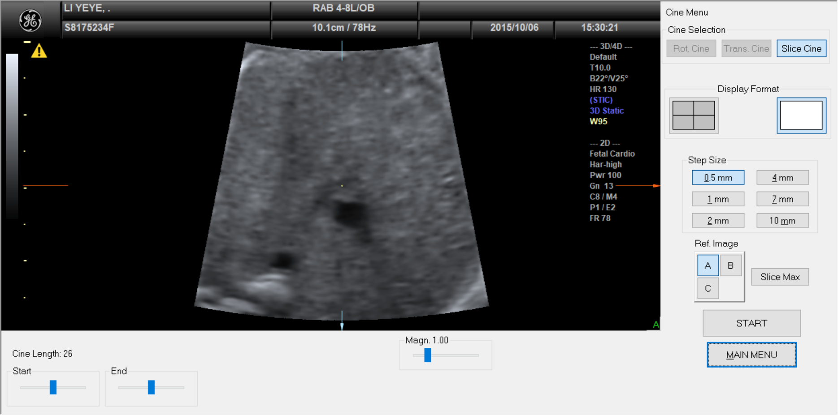

Calculate cine at each time point 1. With same cine length (adjust start and end slice until cannot see ventricle)
2. Step size: 0.5mm
3. Press Start
2
3
1
4D View

Slide 12
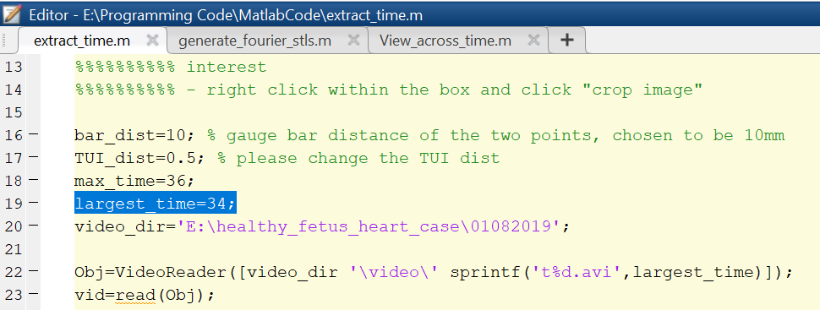
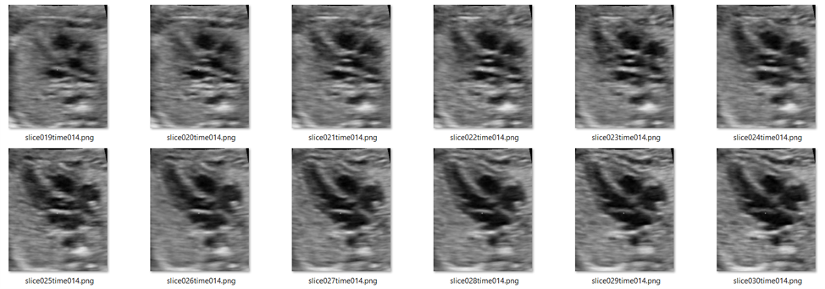
Generate Slices: AVI to PNG

Slide 13
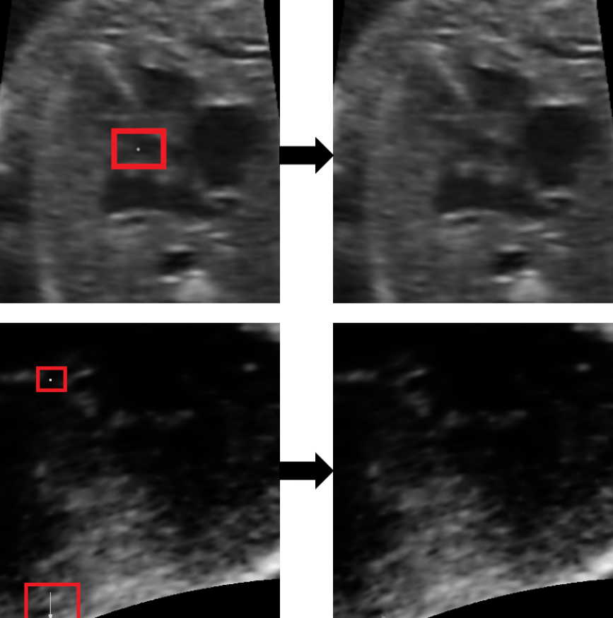
Preprocessing
The ultrasound intensity images contains some artifacts like constant white boxes or arrows
linear interpolation method was used to remove them
defected area was interpolated using the intensity values from the interpolation line

Slide 14
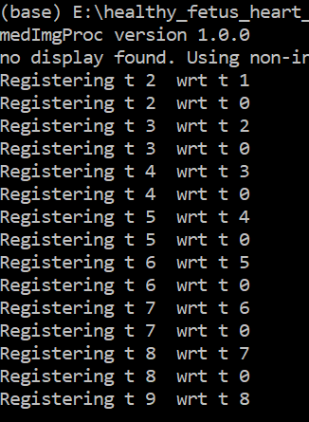
Image Registration
Register image with respect to t1 and the previous time point
Libraries used:
SimpleElastix
Cardiac motion estimation library by Wiputra et al. (2020)[1] [https://github.com/WeiXuanChan/motionSegmentation]
uses the Fourier b-splines spatiotemporal motion model to fit the deformation fields.

Slide 15
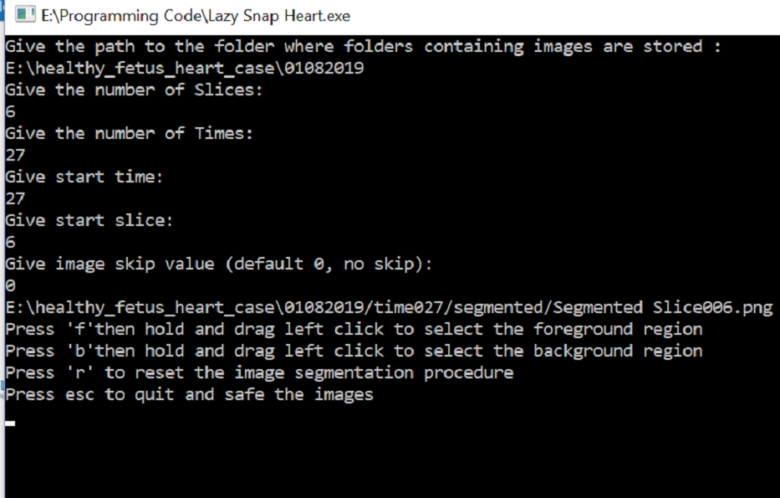
Image Segmentation (lazysnap)
Two time points to segment
End-systolic
End-diastolic

Slide 16
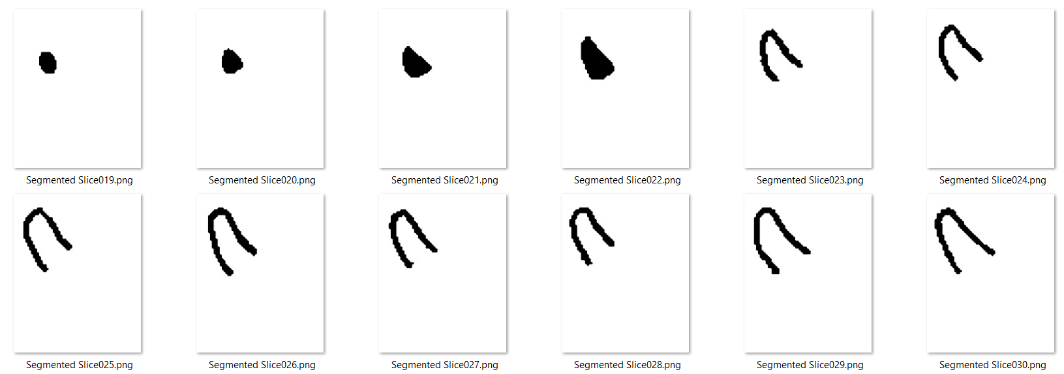

Slide 17
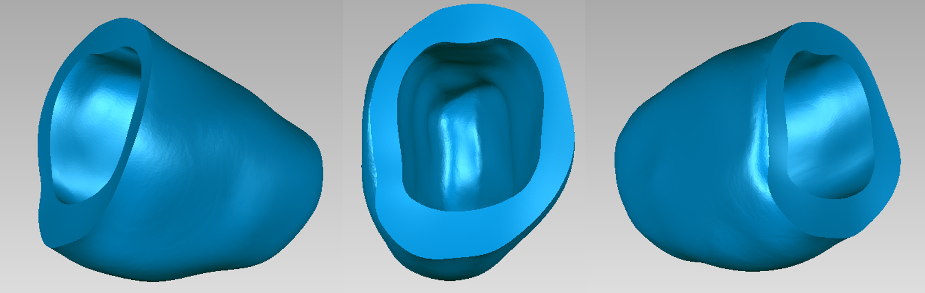
3D Reconstruction
vmtk(Vascular Modeling Toolkit) was used to generate the 3D masks
Generated 3D masks have artifacts like holes, spikes, edges etc which was corrected and smoothened using Geomagic by an expert.

Slide 18
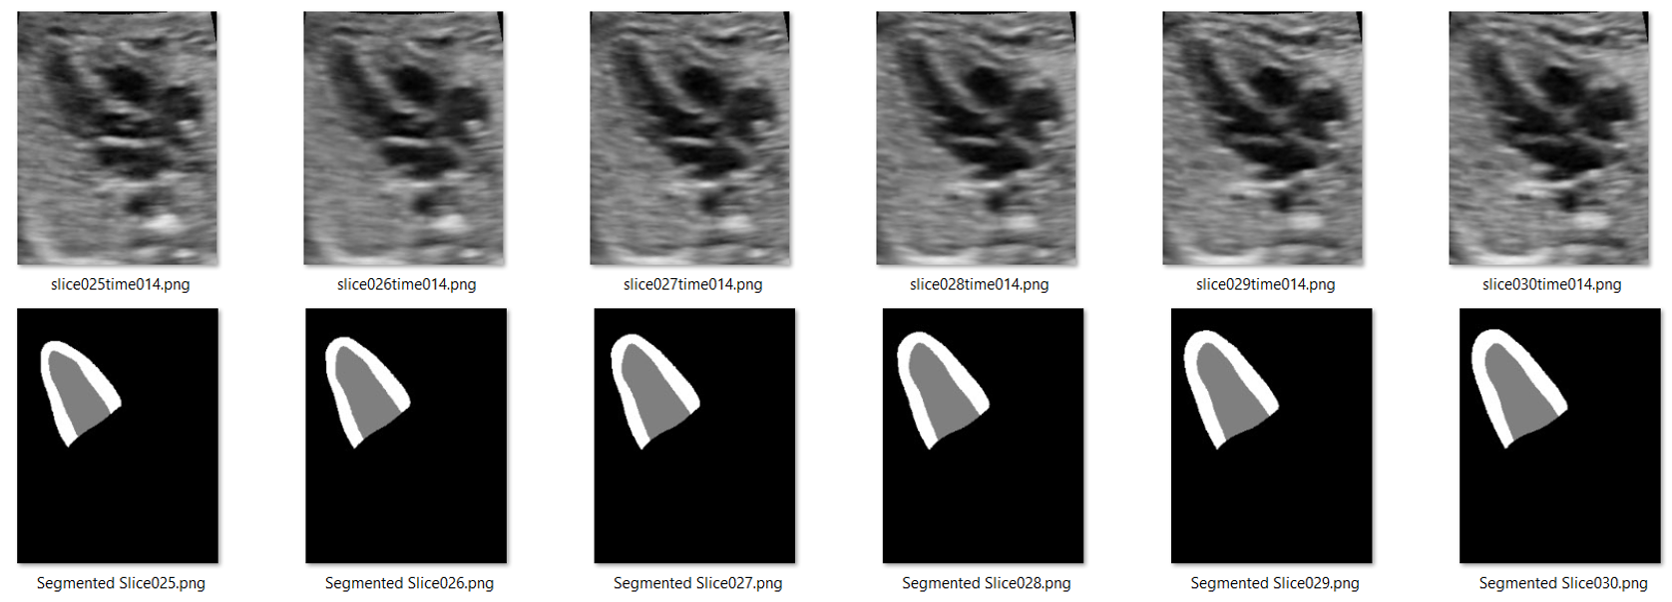
Image-Mask Pair

Slide 19
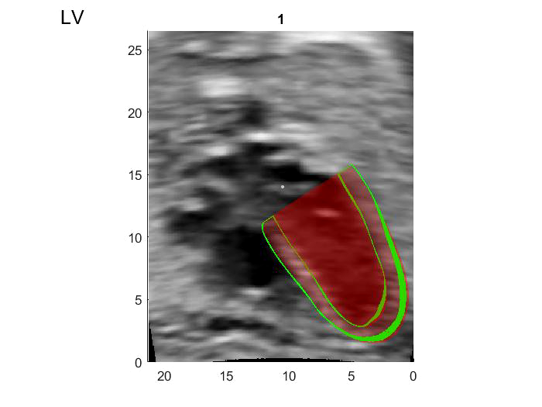
Image-Mask Pair

Slide 20
H: Healthy
D: Diseased
Fetal 3D Dataset
14 Cases (4D with Time)
Train: 10 Cases
( 2-H, 8-D)
Val : 4 Cases
( 2-H, 2-D)
381 3D Volumes
Pairs of fixed and moving
123 3D Volumes
Pairs of fixed and moving

Slide 21
CAMUS 2D Dataset
We have also applied our experimental methods on
a well-known adult 2D echocardiography dataset.[5]
We wanted to compare the performances in 2D vs 3D
Also in adult vs fetal echocardiography
CAMUS dataset comprises :
i) a training set of 450 patients along with the
corresponding manual references;
ii) a testing set composed of 50 new patients.

Slide 22
Proposed registration Framework

Slide 23
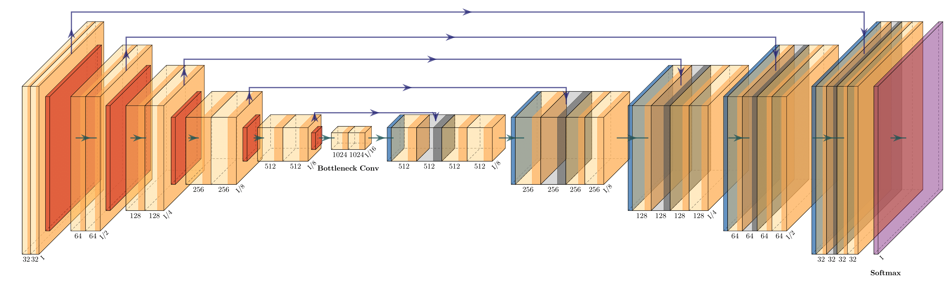
(1) Proposed Residual Segmentation branch
Based on the traditional UNET architecture with skip connections. (Input Image: 256*256*32)
The conventional path cannot degrade the features’ quality as a non-zero regularizing path will skip over them. On the other hand, the direct skipping of the non-zero regularizing path cannot hamper the performance as it has been added to the conventional path's learned features.

Slide 24
(2) Multi-class Anatomically Constrained and multi-scale registration
The proposed registration method has the following integral parts:
Local and global anatomical constraints using variational autoencoders
2. Adversarial learning as like zero-sum game theory (one agent's gain is
another agent's loss), where the discriminator is used to classify moved
and fixed images
3. Multi-scale (multi-resolution) training, where trained parameters in lower
scale are used to initialize the higher scale training (Future works for 3D)

Slide 25
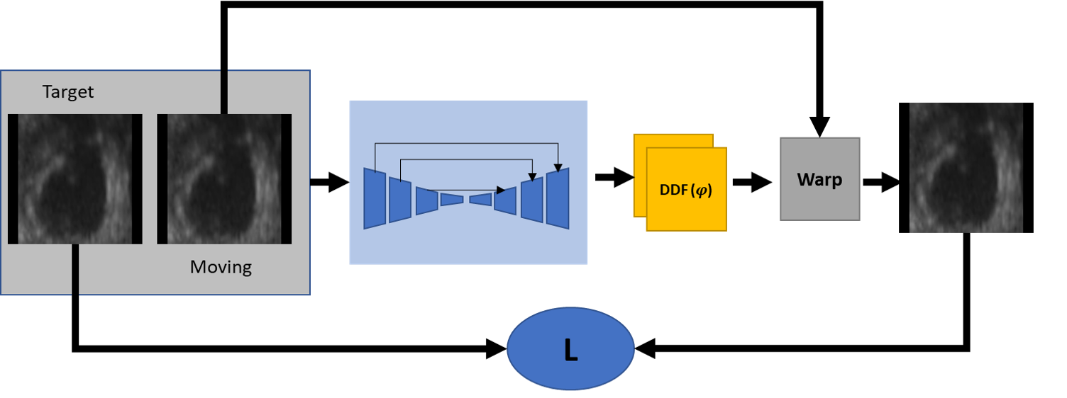
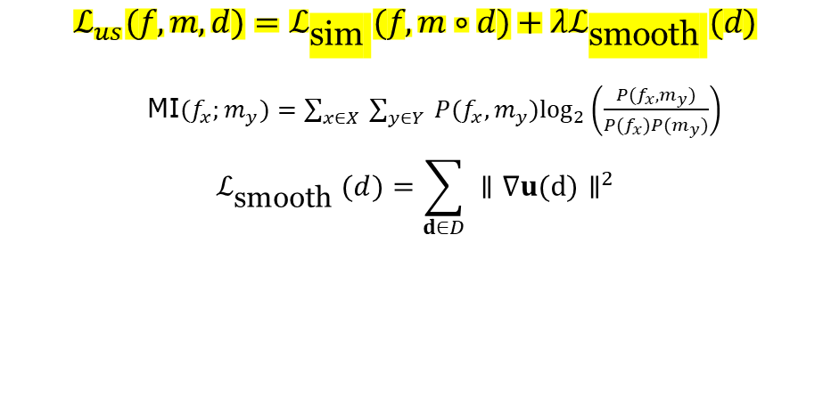
Vanilla-DLIR
Typical unsupervised Registration without considering anatomy.
$$ℒ_{us}(f,m,d)=ℒ_{\text{sim} }(f,m∘d)+λℒ_{\text{smooth} }(d)$$
MI$(f_{x};m_{y})=\sum_{x∈X}{ }\sum_{y∈Y}{ }P(f_{x},m_{y})\log_{2}⁡\left(\frac{P(f_{x},m_{y})}{P(f_{x})P(m_{y})}\right)$
$$ℒ_{\text{smooth} }(d)=\sum_{d∈D}{ }∥∇u(d)∥^{2}$$
The unsupervised loss can be derived using MI loss and binding energy regularization loss

Slide 26
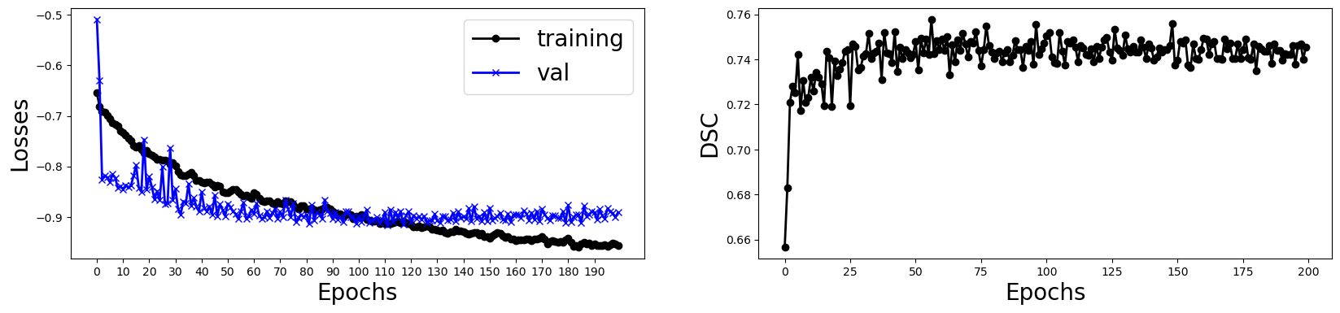
Results on Fetal Dataset (3D) – Longitudinal Registration
Vanilla-DLIR
MSEMetric W/O registration = 0.00377
MSEMetric W/ registration = 0.00296
BG LV Myo
Mean dice W/O registration = [0.99093 0.78917 0.72605]
Mean dice W/ registration = [0.98699 0.70087 0.58543]

Slide 27
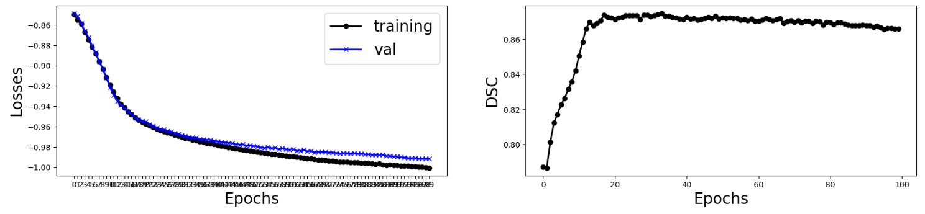
Results on CAMUS Dataset (2D) - Longitudinal Registration
Vanilla-DLIR
MSEMetric W/O registration = 0.00972
MSEMetric W/ registration = 0.0042
BG LV Myo
Mean dice W/O registration = [0.96678 0.76046 0.69391]
Mean dice W/ registration = [0.97352 0.87523 0.74977]

Slide 28
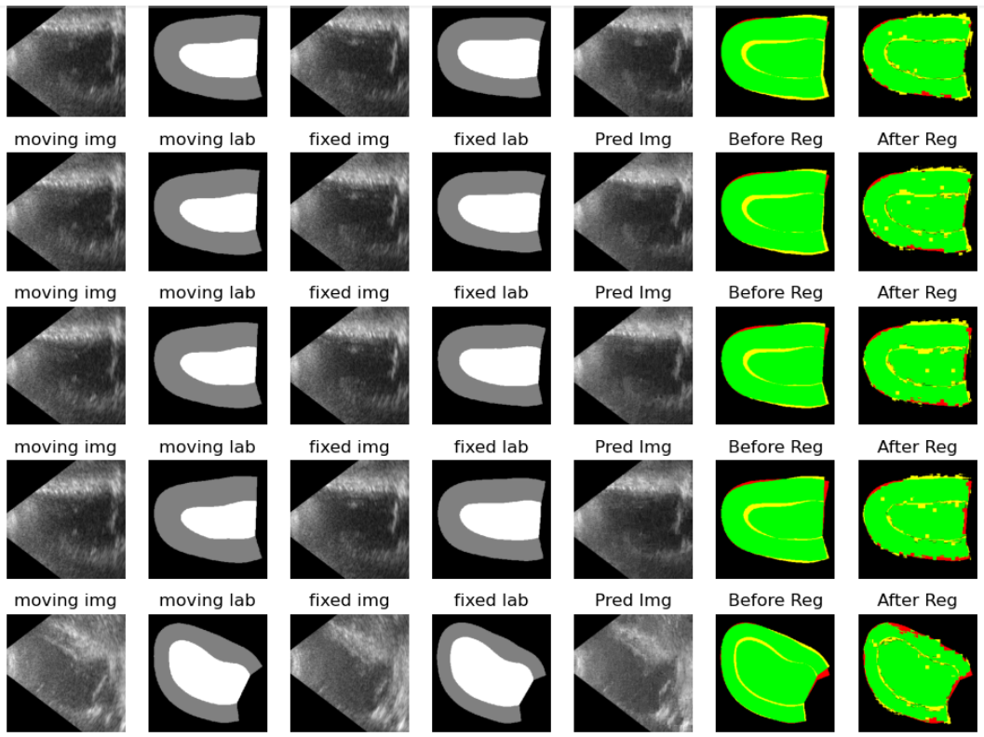
Vanilla-DLIR

Slide 29
Vanilla-DLIR
Observation:
In the unsupervised registration without considering the anatomy, the similarity between two intensity images increases, but the similarity between fixed and moved masks does not improve satisfactorily or fail in some cases.
Thanks to those two following papers that solved this limitation.
[1] Balakrishnan, Guha, et al. "VoxelMorph: a learning framework for deformable medical image registration." IEEE transactions on medical imaging 38.8 (2019): 1788-1800.
[2] Hu, Yipeng, et al. "Label-driven weakly-supervised learning for multimodal deformable image registration." 2018 IEEE 15th International Symposium on Biomedical Imaging (ISBI 2018). IEEE, 2018.

Slide 30

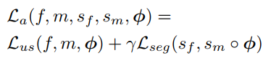
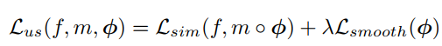
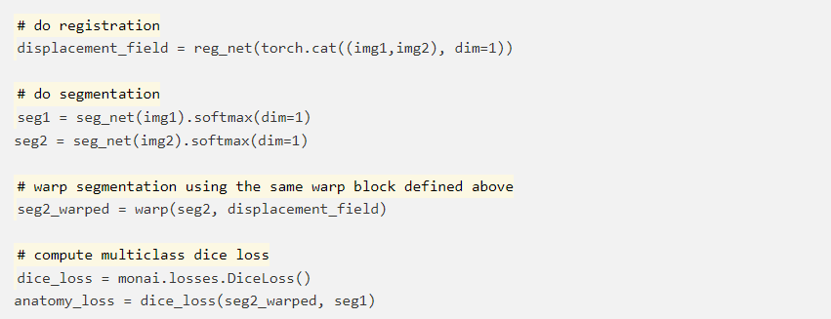
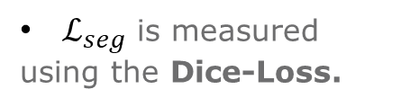

Target
DDF ($φ$)
Warp
Moving
Target
Warp
Moving
L_{sim}
L_{ov}
$ℒ_{seg}$ is measured
using the Dice-Loss.

Slide 31
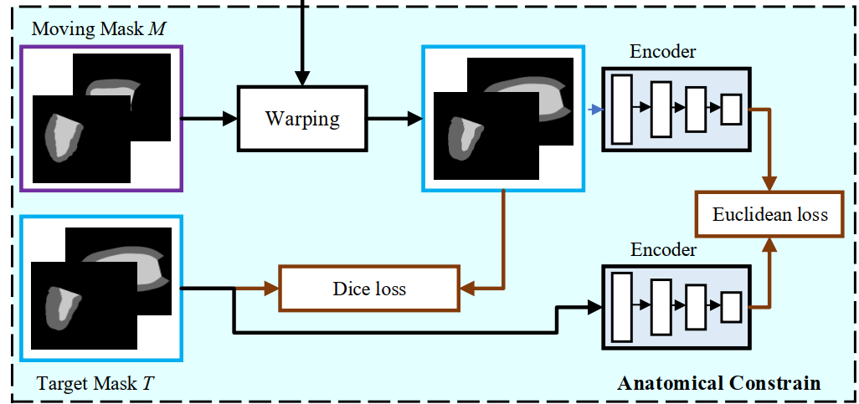
Rationale for Latent Space consideration
To improve the network's anatomical context:
Intensity-based similarity loss (fixed and moving intensity images) with a segmentation-aware loss (fixed and moved labels) are combined.
This new loss measures the alignment between a target anatomical mask and a warped moving mask.

Slide 32
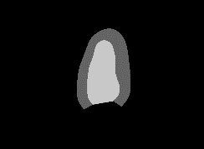
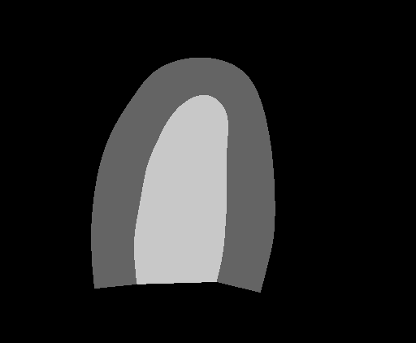
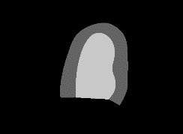
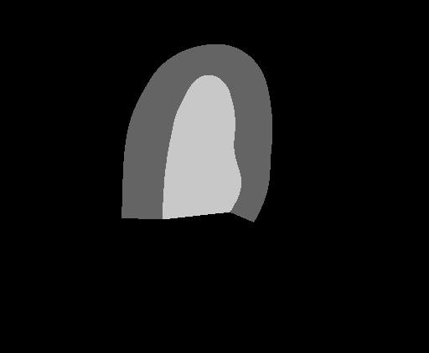
Learning Global Anatomical Features
Encoder
Global features, f(x)=h
h is a latent variable
Input Shapes (x)
Loss
Cross-entropy loss (x, y)
KL loss
[NEW] Similarity loss (x, y)
like DSC, SSIM etc
h
Decoder
Reconstructed Shapes (y)
The regularization loss named Kullback-Leibler (KL) divergence forces the distributions returned by the encoder to be close to a standard normal distribution.

Slide 33
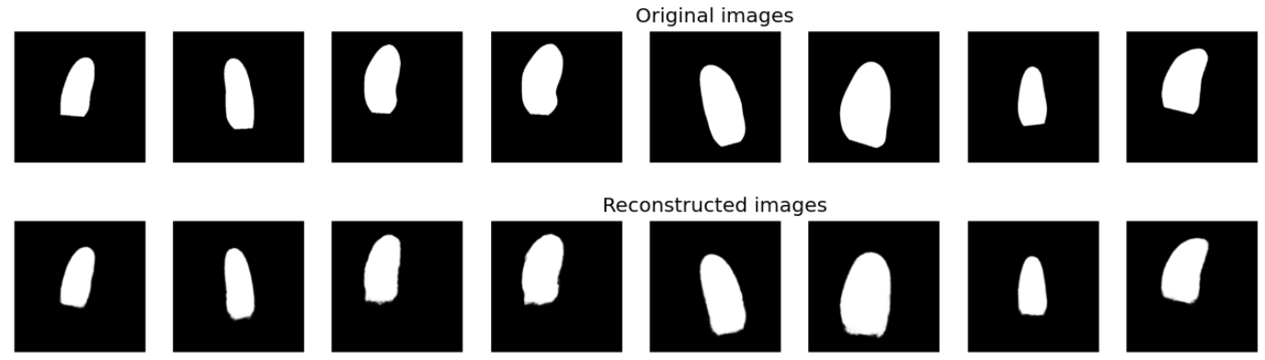
Goal from Global attributes
Orientation, Shape, and Size
Best Val Dice = 0.9789

Slide 34
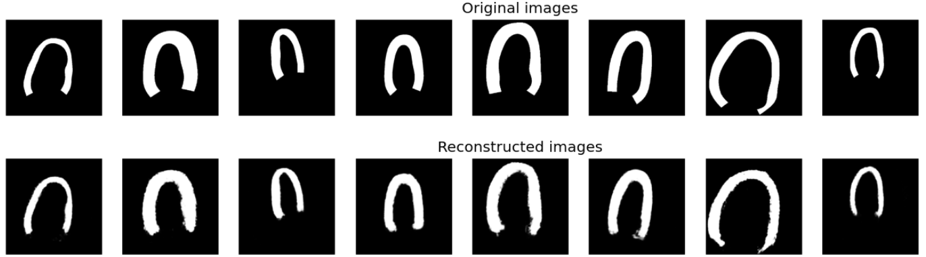
Goal from Global attributes
Orientation, Shape, and Size
Best Val Dice = 0.9407

Slide 35
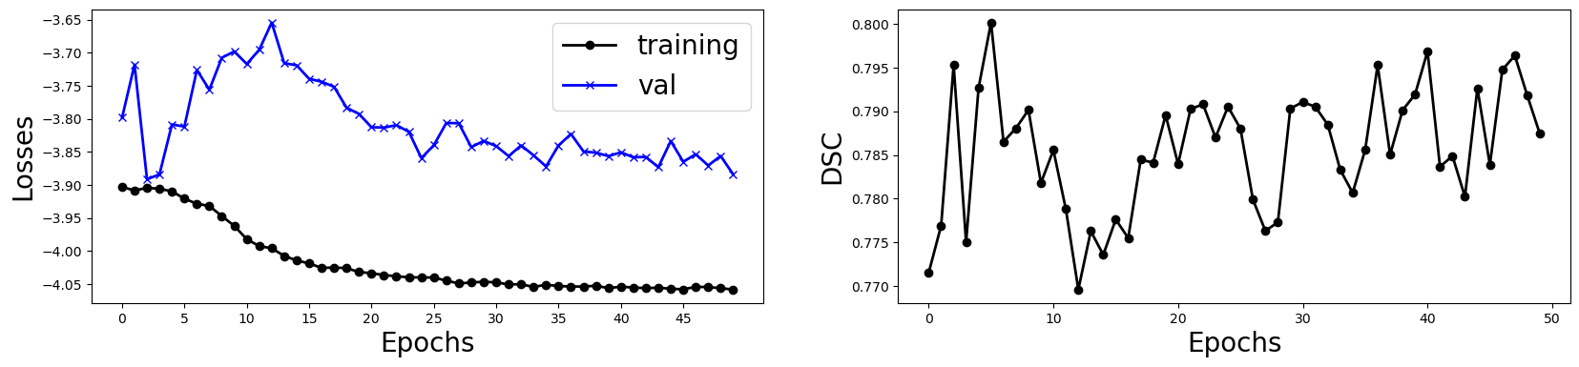
Results on Fetal Dataset (3D) – Longitudinal Registration
AC-DLIR
MSEMetric W/O registration = 0.00377
MSEMetric W/ registration = 0.00251
BG LV Myo
Mean dice W/O registration = [0.99093 0.78917 0.72605]
Mean dice W/ registration = [0.98959 0.73347 0.64435]

Slide 36
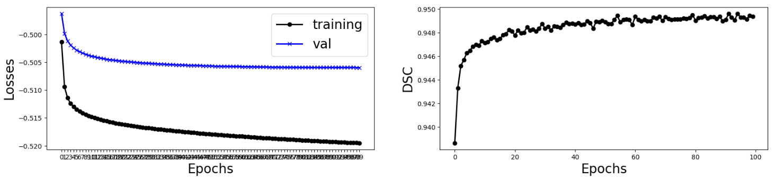
Results on CAMUS Dataset (2D) - Longitudinal Registration
AC-DLIR
MSEMetric W/O registration = 0.00972
MSEMetric W/ registration = 0.00598
BG LV Myo
Mean dice W/O registration = [0.96678 0.76046 0.69391]
Mean dice W/ registration = [0.97972 0.91935 0.81437]

Slide 37
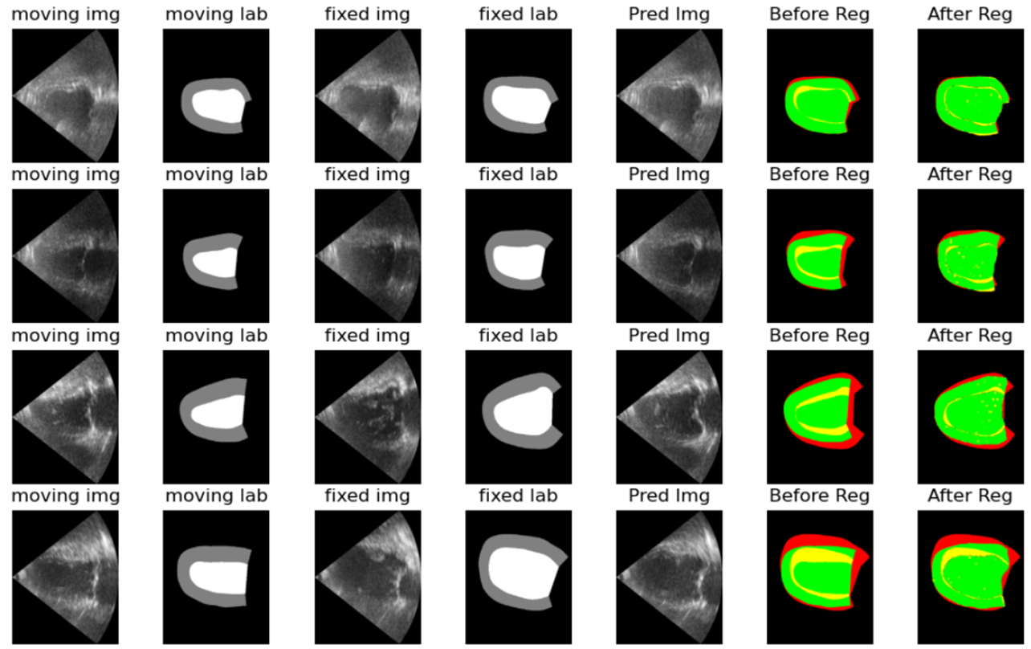
AC-DLIR

Slide 38
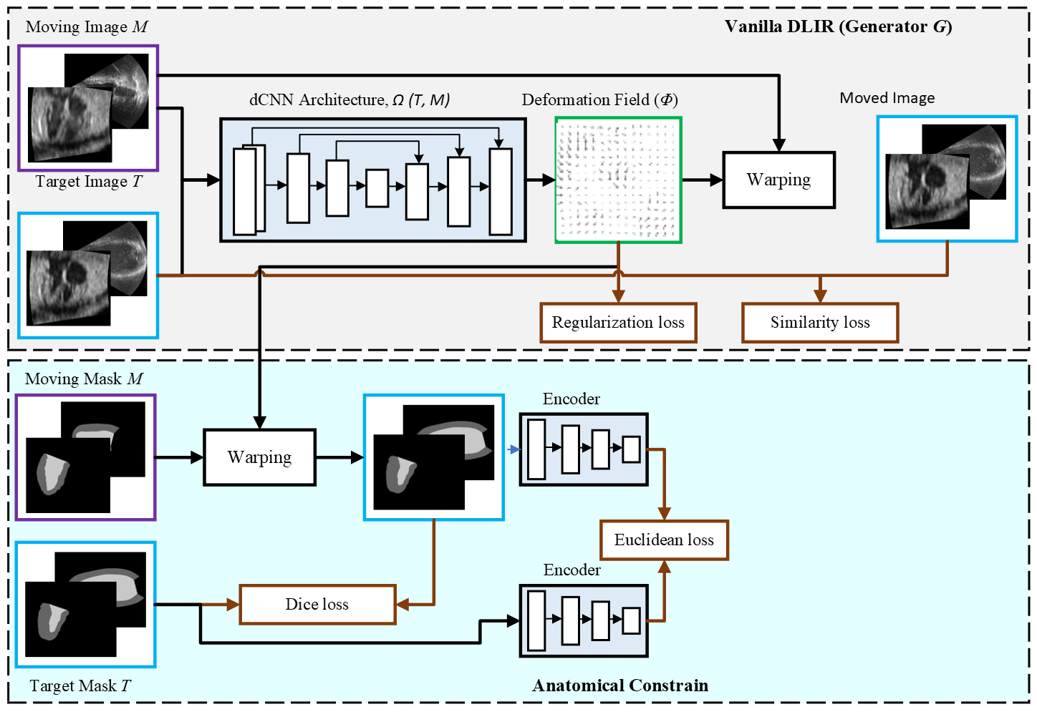
Anatomically constrained DLIR (AC-DLIR)

Slide 39
Adversarial AC-DLIR (AdvAC-DLIR)
Still, there is room for performance improvement.
Hence, we proposed Adversarial Anatomically constrained (AdvAC) DLIR framework.
The part of AC-DLIR for generating the deformable images as a generator for the adversarial network.
A discriminator was also trained which was able to classify the fixed and moved images
While training, the generator would try to create as much as plausible images as the fixed image whereas the discriminator would try to discriminate them.

Slide 40
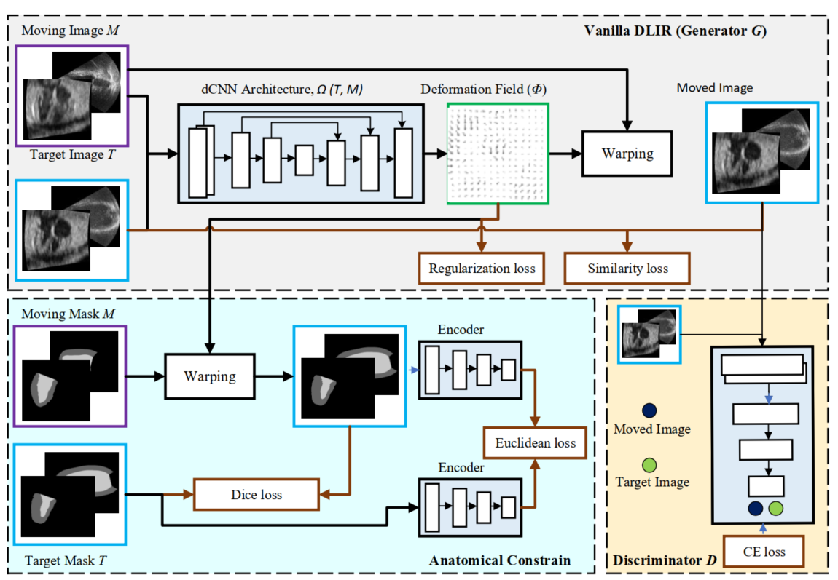
Adversarial AC-DLIR (AdvAC-DLIR)

Slide 41
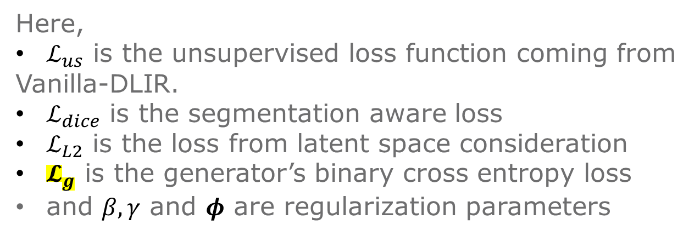
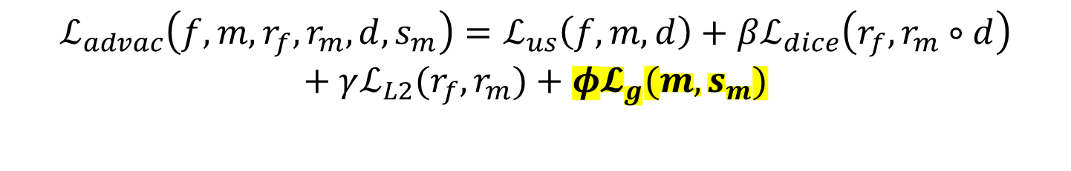
Proposed Loss Functions
$$ℒ_{advac}\left(f,m,r_{f},r_{m},d,s_{m}\right)=ℒ_{us}\left(f,m,d\right)+βℒ_{dice}\left(r_{f},r_{m}∘d\right)$$
$$+ γℒ_{L2}(r_{f},r_{m})+φ𝓛_{g}(m,s_{m})$$
Here,
$ℒ_{us}$ is the unsupervised loss function coming from
Vanilla-DLIR.
$ℒ_{dice}$ is the segmentation aware loss
$ℒ_{L2}$ is the loss from latent space consideration
$𝓛_{g}$ is the generator’s binary cross entropy loss
and $β, γ$ and $φ$ are regularization parameters

Slide 42
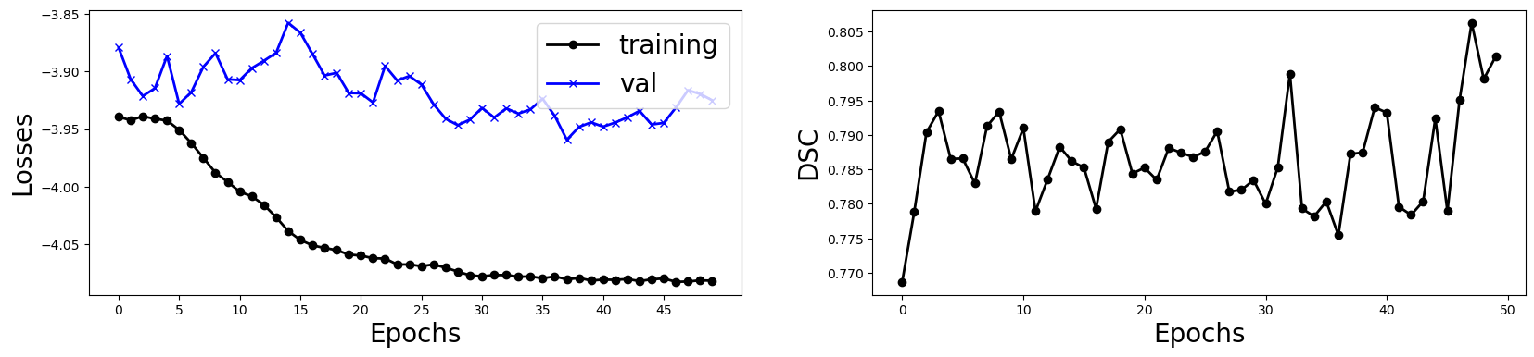
Results on Fetal Dataset (3D) – Longitudinal Registration
AdVAC-DLIR
MSEMetric W/O registration = 0.00377
MSEMetric W/ registration = 0.00258
BG LV Myo
Mean dice W/O registration = [0.99093 0.78917 0.72605]
Mean dice W/ registration = [0.99089 0.79884 0.73482]

Slide 43
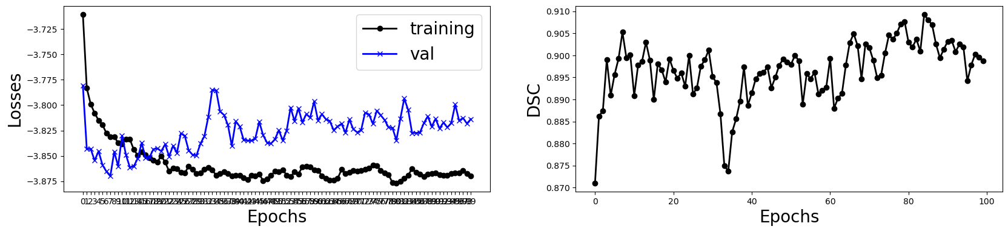
Results on CAMUS Dataset (2D) - Longitudinal Registration
AdVAC-DLIR
MSEMetric W/O registration = 0.00972
MSEMetric W/ registration = 0.00589
BG LV Myo
Mean dice W/O registration = [0.96678 0.76046 0.69391]
Mean dice W/ registration = [0.98742 0.93573 0.82751]

Slide 44
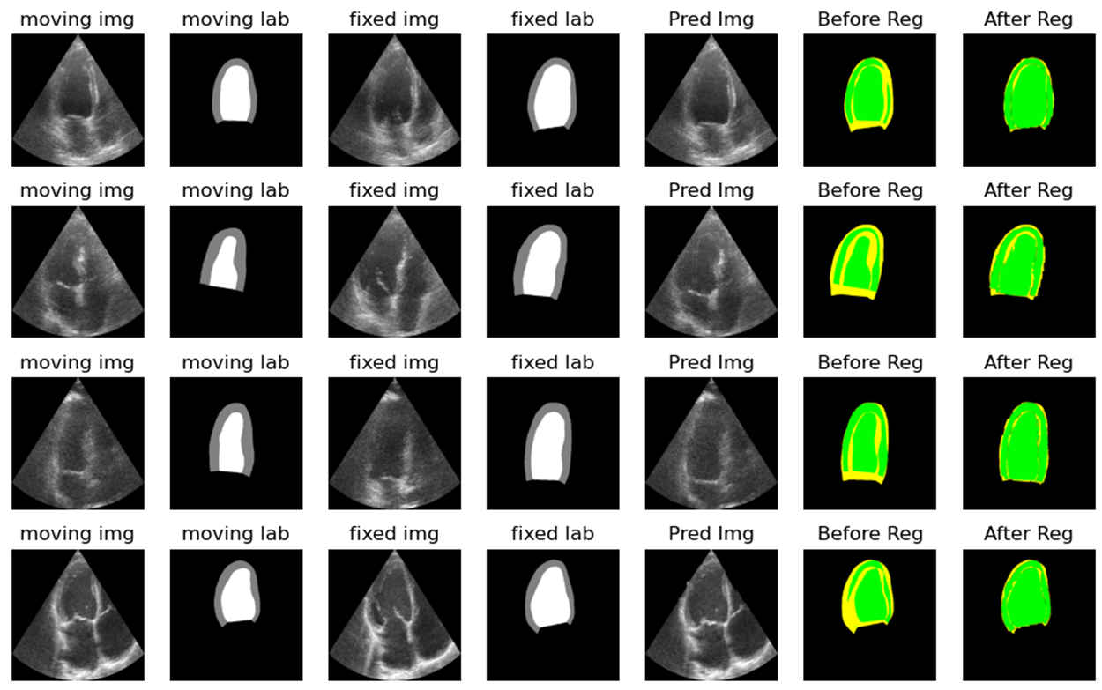
AdVAC-DLIR

Slide 45
Results (Fetal 3D)
Model | MSE | Dice Score |  |  | Mean Dice ±std
 |  | Background | LV | Myo
Without Registration | 0.00377 | 0.99093 | 0.78917 | 0.72605 | 0.83539± 0.12798
Vanilla-DLIR | 0.00296 | 0.98699 | 0.70087 | 0.58543 | 0.75776± 0.04036
AC-DLIR | 0.00251 | 0.98959 | 0.73347 | 0.64435 | 0.80013± 0.05401
Adv-DLIR | 0.00339 | 0.99031 | 0.73836 | 0.67389 | 0.80989± 0.05142
AdvAC-DLIR | 0.00258 | 0.99089 | 0.79884 | 0.73482 | 0.84668± 0.04586

Slide 46


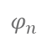
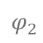
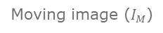
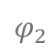
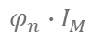
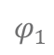
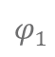
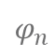
Future Plan :MACMR framework
Target
Moving
Target
Moving
Target
Moving
Intensity image pair
Mask image pair
Intensity image pair
$$φ_{1}$$
Scale 1
$$φ_{n}$$
Moving image ($I_{M}$)
$$φ_{2}$$
$$φ_{2}$$
Scale 2
$$φ_{1}$$
………….
………….
………….
$$φ_{n}∙I_{M}$$
$$φ_{n}$$
Moved image
Scale n
Training Phase
Inference Phase
Multi-scale (multi-resolution) training, where trained parameters in lower scale are used to initialize the higher scale training

Slide 47
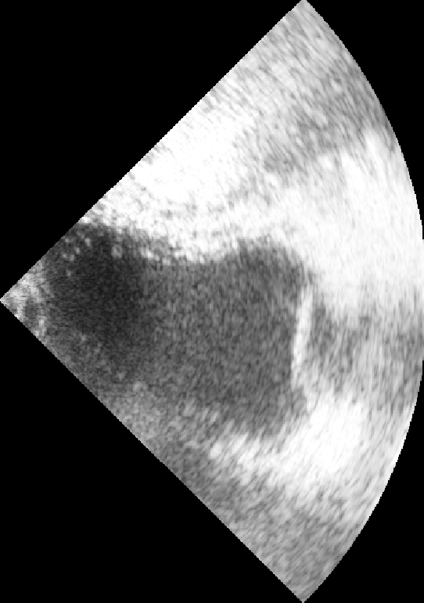

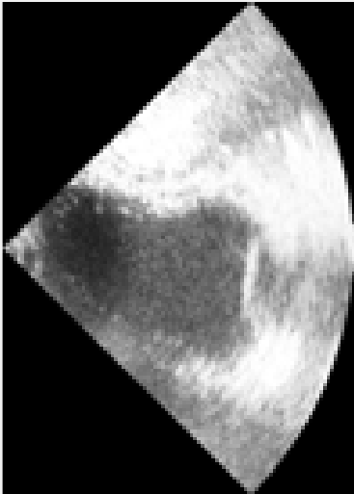




Original
Pool-1 (stride 2)
Pool-2 (stride 2)
Pool-3 (stride 2)
Pool-4 (stride 2)
Pool-5 (stride 2)

Slide 48






Results on CAMUS dataset
Scale 1 ($112×144$)
Scale 2 ($224×288$)
Scale 3 ($448×576$)

Slide 49
Results (CAMUS 2D)
Model | MSE | Dice Score |  |  | Mean Dice ±std
 |  | Background | Myo | LV
Without Registration | 0.00972 | 0.96678 | 0.69391 | 0.76046 | 0.80235± 0.05491
Vanilla-DLIR | 0.0042 | 0.97352 | 0.74977 | 0.87523 | 0.88487± 0.03261
AC-DLIR | 0.00598 | 0.97972 | 0.81437 | 0.91935 | 0.90303± 0.03447
Adv-DLIR | 0.00533 | 0.97429 | 0.79278 | 0.86842 | 0.85733± 0.04129
AdvAC-DLIR | 0.00589 | 0.98742 | 0.82751 | 0.93573 | 0.91689± 0.02596
MACMR | 0.00489 | 0.98779 | 0.84871 | 0.95423 | 0.94245± 0.02474

Slide 50
Conclusion
The clinical use of echo is still stuck with 2D, so a more robust and precise automatic registration and segmentation framework is really needed
Proposed AdvAC model outperforms all the previous experiments and thus proved to be the best model working in both the 2D and 3D dataset.
Still, there is room for performance improvement.
More annotated data for 3D will be needed for further performance improvement.

Slide 51
Future Plans
Annotate more cases for 3D fetal data
Apply the multi-resolution (MACMR) framework for 3D data
Proceed with the 3D segmentation of heart chamber and myocardium
Measure various identifiers as heart shapes, ejection fraction, volume etc. to perform disease detection and classification for fetal heart abnormalities

Slide 52
References
Wiputra, H., Chan, W.X., Foo, Y.Y., Ho, S., Yap, C.H., 2020. Cardiac motion estimation from medical images: a regularisation framework applied on pairwise image registration displacement fields. Scientific Reports 10.
Balakrishnan, Guha, et al. "VoxelMorph: a learning framework for deformable medical image registration." IEEE transactions on medical imaging 38.8 (2019): 1788-1800.
Hu, Yipeng, et al. "Label-driven weakly-supervised learning for multimodal deformable image registration." 2018 IEEE 15th International Symposium on Biomedical Imaging (ISBI 2018). IEEE, 2018.
Oktay, O., Ferrante, E. et al., 2017. Anatomically constrained neural networks (acnns): Application to cardiac image enhancement and segmentation. IEEE Transactions on Medical Imaging 37, 384–395
Leclerc, S., Smistad, E., et al., 2019. Deep learning for segmentation using an open large-scale dataset in 2d echocardiography. IEEE Transactions on Medical Imaging 38, 2198–2210. doi:10.1109/TMI.2019.2900516
Chen, X., Diaz-Pinto, A., Ravikumar, N., Frangi, A.F., 2021. Deep learning in medical image registration. Progress in Biomedical Engineering 3, 012003.
Li, Y., Sun, J., Tang, C.K., Shum, H., 2004. Lazy snapping. ACM SIGGRAPH 2004 Papers .
Ronneberger, O., Fischer, P., Brox, T., 2015. U-net: Convolutional networks for biomedical image segmentation. ArXivabs/1505.04597
Yan, P., Xu, S., Rastinehad, A.R., Wood, B.J., 2018. Adversarial image registration with application for mr and trus image fusion, in: MLMI@MICCAI.
Green, L., Chan, W.X., Ren, M., Mattar, C.N.Z., Lee, L.C., Yap, C.H., 2023. The dependency of fetal left ventricular biomechanics function on myocardium helix angle configuration. Biomechanics and modeling in mechanobiology 22, 629—643.
Izzo, R., Steinman, D.A., Manini, S., Faggiano, E., Antiga, L., 2018. The vascular modeling toolkit: A python library for the analysis of tubular structures in medical images. J. Open Source Softw. 3,745.
Lowekamp, B., gabehart, Blezek, D., Marstal, K., Ibanez, L., Chen, D., McCormick, M., Mueller, D., Johnson, H., Cole, D., Yaniv, Z., Posthuma, J., Beare, R., Gelas, A., aghayoor, ltong1130ztr, fsantini, adizhol, Subburam, K., Fillion-Robin, J.C., Anthony, Doria, D., King, B., 2016. kaspermarstal/simpleelastix: v0.10.0.

Slide 53
References
13. Nurmaini, Siti et al. “Deep Learning-Based Computer-Aided Fetal Echocardiography: Application to Heart Standard View Segmentation for Congenital Heart Defects Detection.” Sensors (Basel, Switzerland) vol. 21,23 8007. 30 Nov. 2021, doi:10.3390/s21238007
14. https://www.creatis.insa-lyon.fr/Challenge/CETUS/
15. E. Smistad and F. Lindseth, “Real-time tracking of the left ventricle in 3D ultrasound using Kalman filter and mean value coordinates,” in Proc. MICCAI Challenge Echocardiogr. Three-Dimensional Ultrasound Segmentation (CETUS), Boston, MA, USA, 2014, pp. 65–72.
16. O. Oktay, W. Shi, K. Keraudren, J. Caballero, and D. Rueckert, “Learning shape representations for multi-atlas endocardium segmentation in 3D echo images,” in Proc. MICCAI Challenge Echocardiogr. Three-Dimensional Ultrasound Segmentation (CETUS), Boston, MA, USA, 2014, pp. 57–64.
17. Christoforos Sfakianakis, Georgios Simantiris, Georgios Tziritas: GUDU: Geometrically-constrained Ultrasound Data augmentation in U-Net for echocardiography semantic segmentation. Biomed. Signal Process. Control. 82: 104557 (2023)
18. Wei, Hongrong et al. “Temporal-Consistent Segmentation of Echocardiography with Co-learning from Appearance and Shape.” International Conference on Medical Image Computing and Computer-Assisted Intervention (2020).
19. Hang Jung Ling, Damien Garcia, Olivier Bernard. Reaching intra-observer variability in 2-D echocardiographic image segmentation with a simple U-Net architecture. IEEE International Ultrasonics Symposium (IUS), Oct 2022, Venice, Italy. ⟨hal-03979523⟩
20. J. Zhang et al., "Dual-Branch TransV-Net for 3D Echocardiography Segmentation," in IEEE Transactions on Industrial Informatics, doi: 10.1109/TII.2023.3249904.

Slide 54
Thank you
Do you have any questions?

